Slide 1
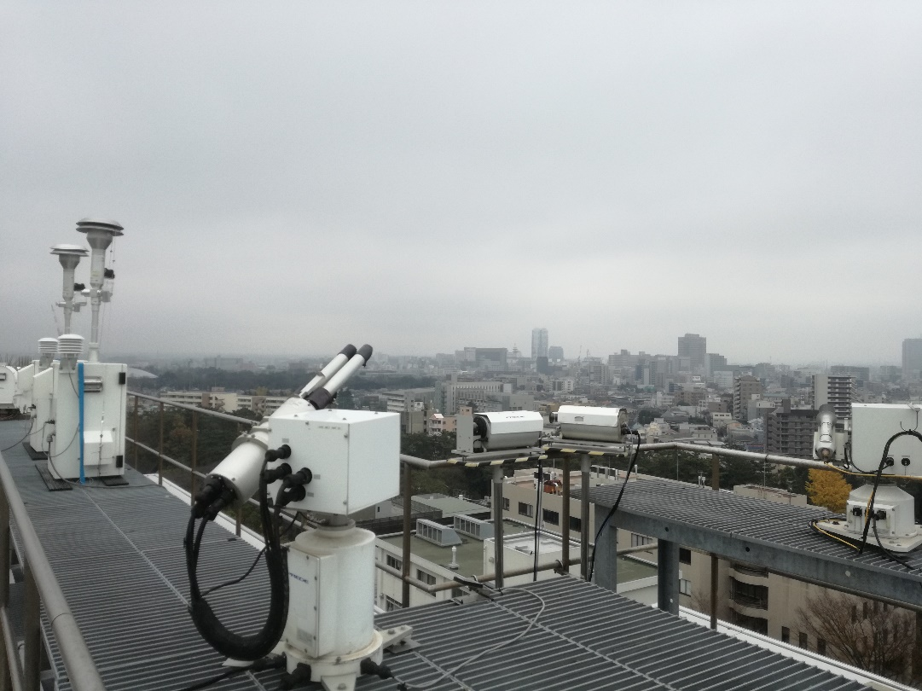
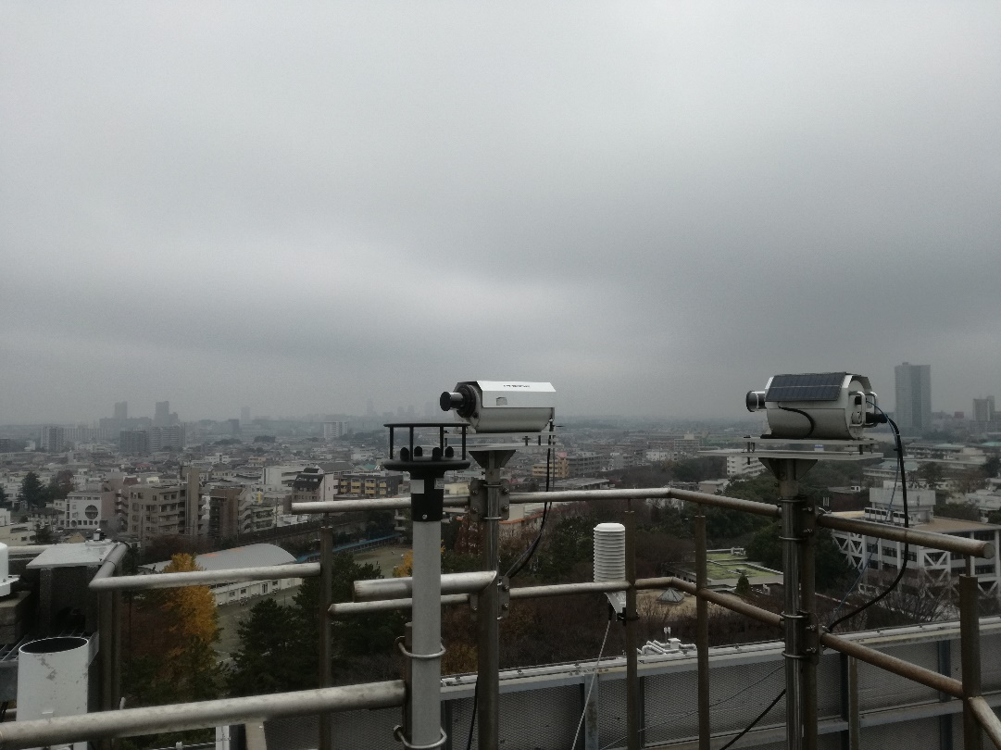
Today’s photo of the site

Slide 2
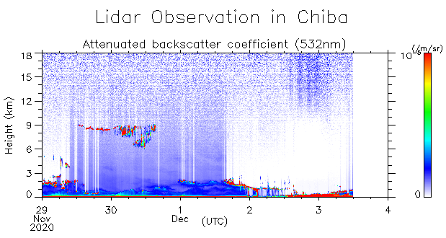
Lidar data
Today’s cloud base was very low!

Slide 3
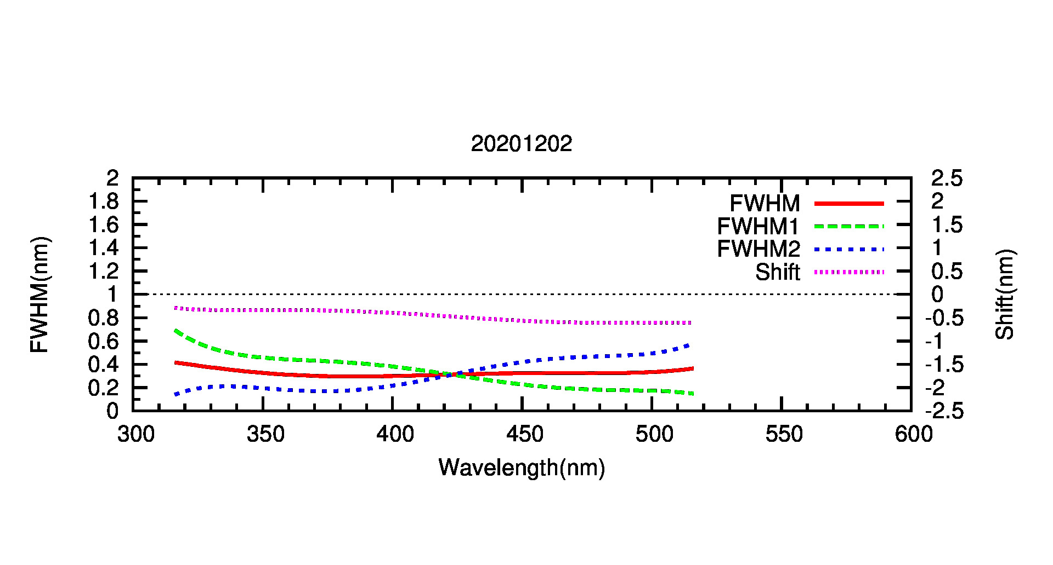
Wavelength calibration result (MAX-DOAS#1)

Slide 4
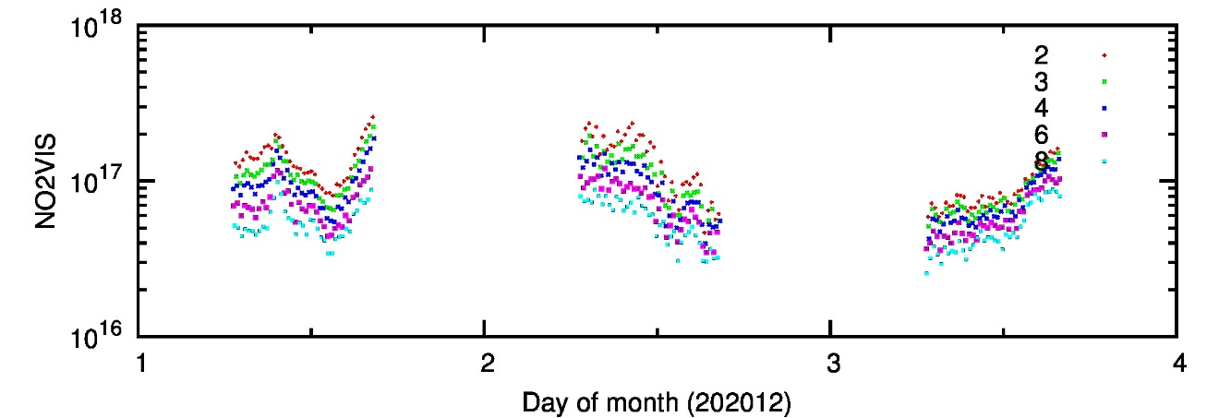
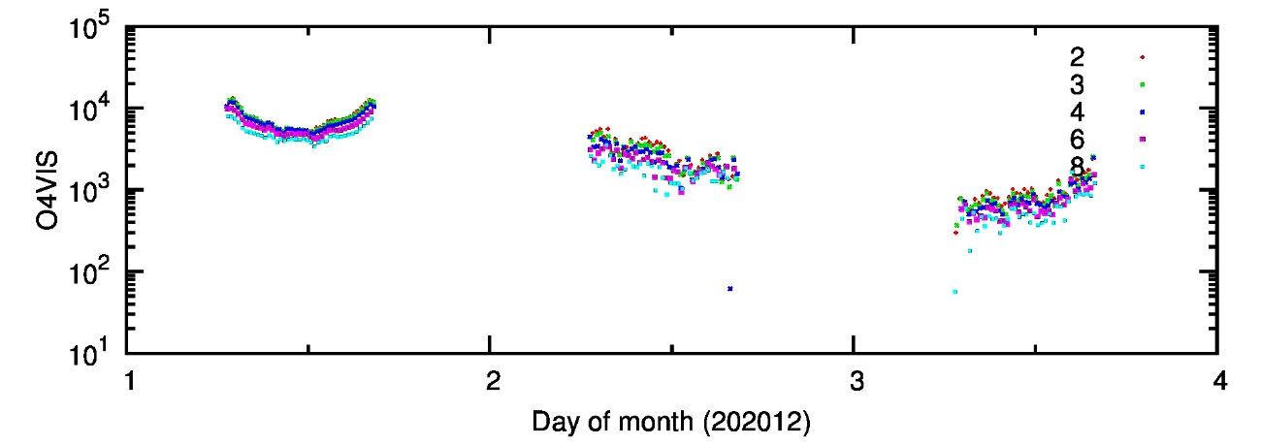
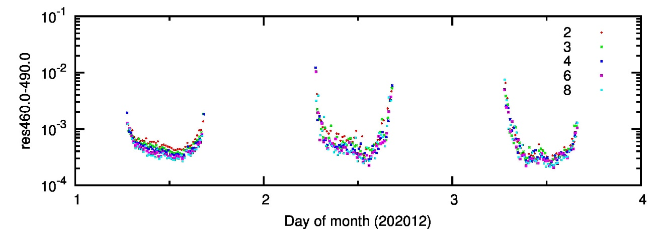
DOAS fitting result (MAX-DOAS#1; 460-490 nm)
NO₂ ΔSCD
O₄ ΔSCD
residual
elevation angle

